Slide 1
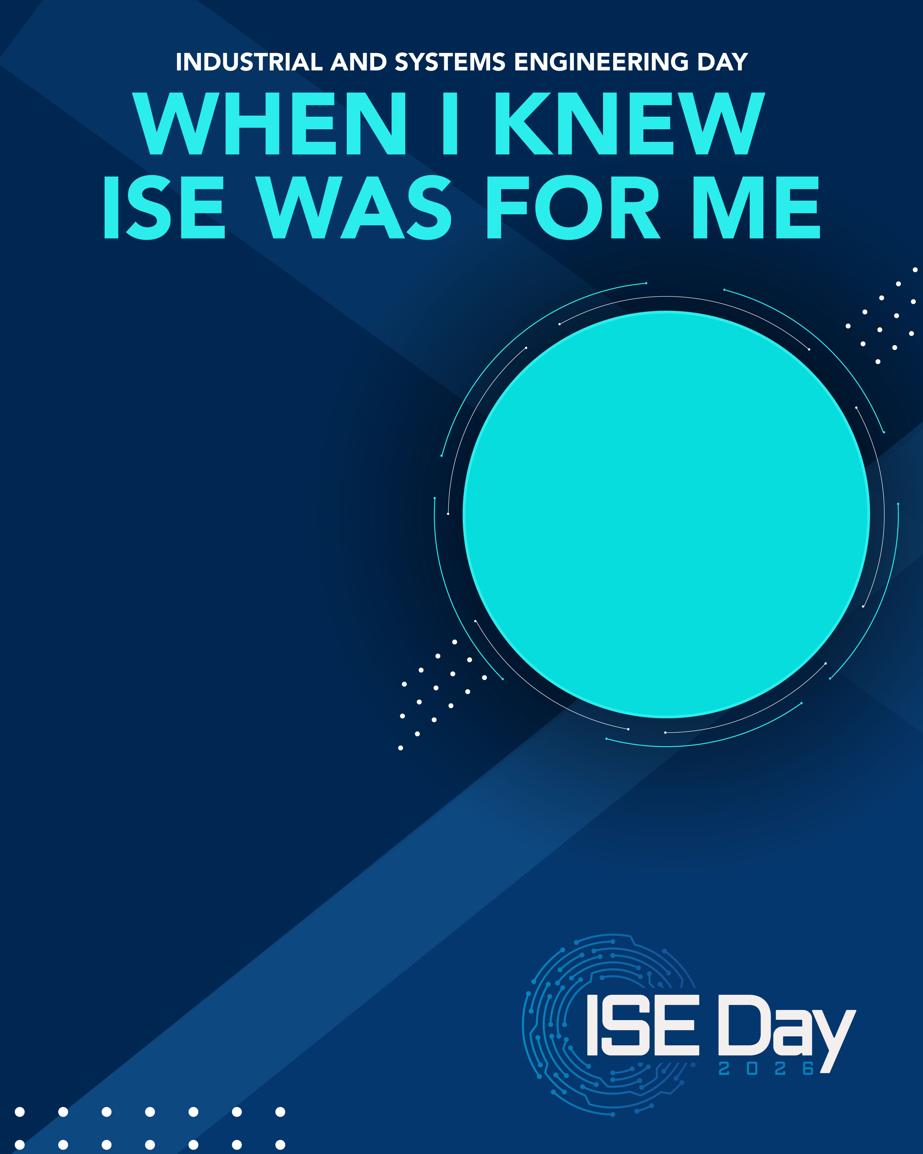
The moment, project, or class that made me realize: “Yes, I am definitely an industrial & systems engineer” was [fill in your answer]
YOUR NAME
Title
Organization
Celebrate #ISEDay
on Sept. 14!
iise.org/ISEDay

